Slide 1

Special Insurance Services, Inc.
Plano, TX

Slide 2
Our History
Founded by the Heusinkveld Group in September 1987
Originally specialized in accident insurance
Hired Phil Rearick to start and run SIS, Inc.

Slide 3
Who we are!
Managing General Underwriter & Reinsurance intermediary
Accident underwriters in-house
Third Party Administrator under the State of Texas

Slide 4
Over 20 years Experience!
Our marketing representatives work directly with agents across the country
We design, implement, & administer our programs in-house
Underwriting
Claim Adjudication
Premium Collections
Policy Issuance
Reinsurance Placement
Commission Payments
In-House

Slide 5
Our Areas of Focus
Occupational Accident
Third Party Administrator
Supplemental Medical
Intercollegiate Sports Insurance
All Lines Accident Programs

Slide 6

Occupational Accident
We have 2 main occupational accident programs for Non-Subscribers:
  Traditional Accident Plans for accident medical, AD&D, and short term disability
  Employer Indemnity Protection with Mediation & Binding Arbitration

Slide 7
Third Party Administrator
Adjudicate all claims in-house
Offer self-funded group health programs
Stop Loss coverage

Slide 8



Supplemental Medical

Slide 9
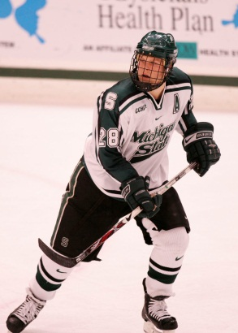
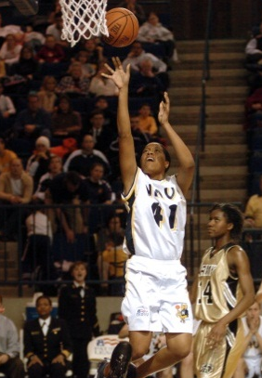
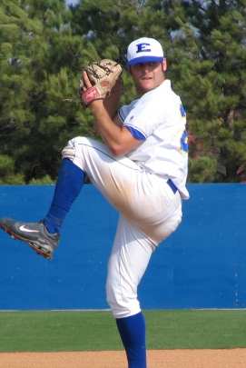
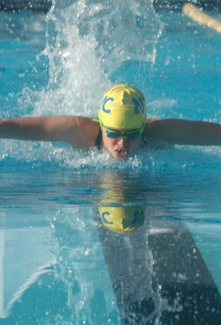
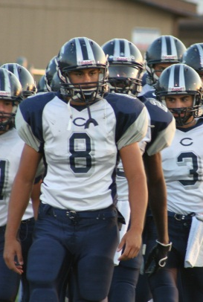
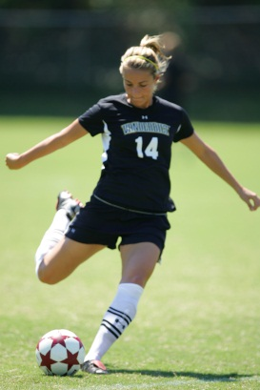
Intercollegiate Sports Insurance
Provide accident coverage to colleges & universities to insure their athletes
  Fully Insured
  Aggregate Deductible

Slide 10
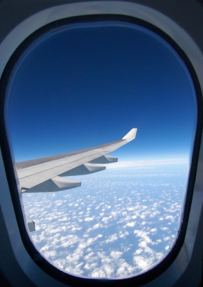
All Lines Accident Programs
Special Risk Policies
  Travel Accident Insurance
  Daycare Participants
  Loss of Use
  High Limit Accidental Death

Slide 11
Special Insurance Services, Inc.
Plano, TX

